Slide 2
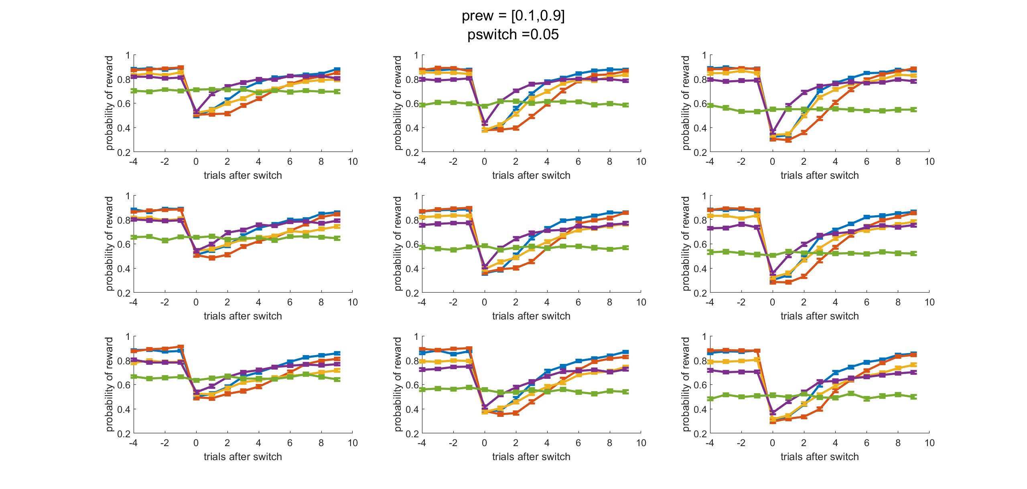
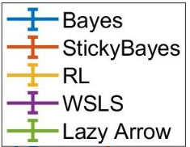
Ndirections
2 3 4
Nbandits
5 4 3

Slide 3
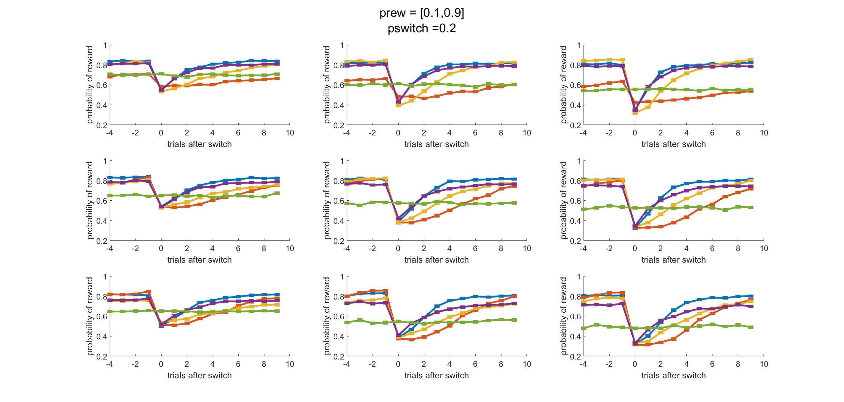
Ndirections
2 3 4
Nbandits
5 4 3

Slide 4
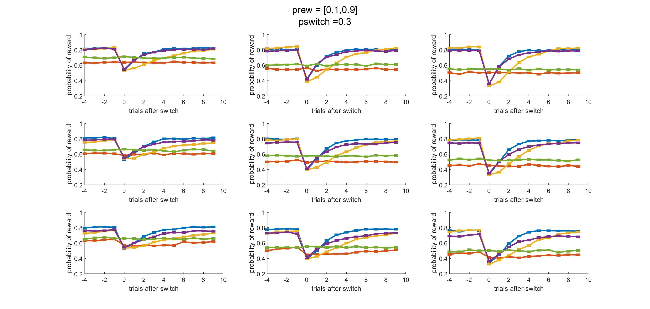
Ndirections
2 3 4
Nbandits
5 4 3

Slide 5
Week 1/17

Slide 6
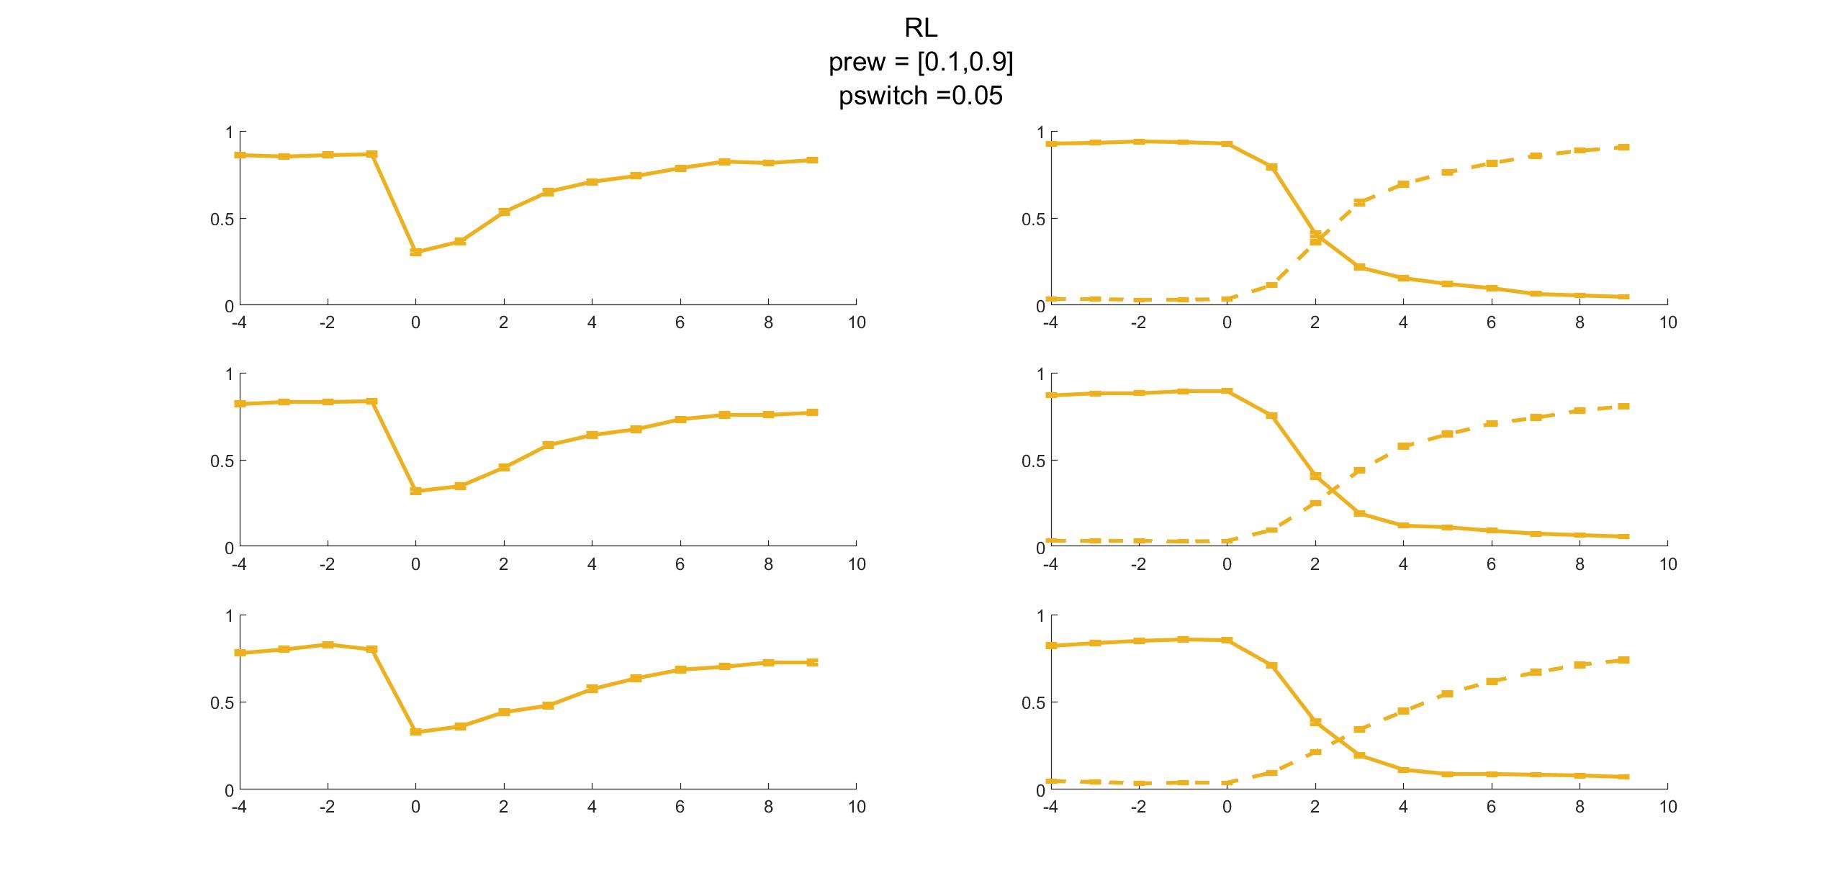
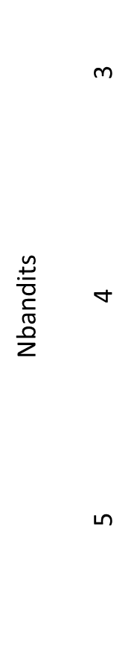
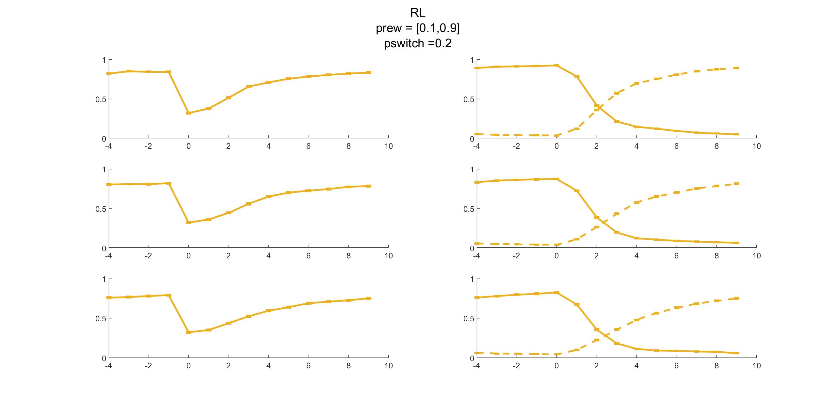

Slide 7
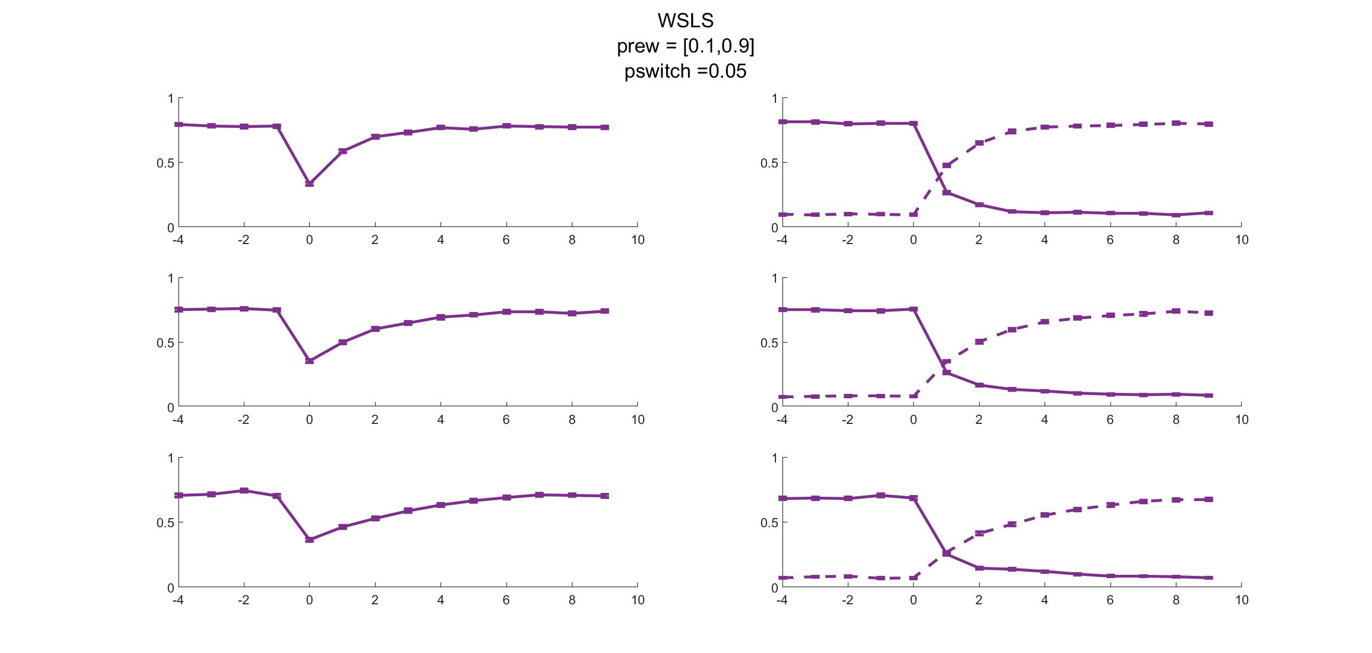
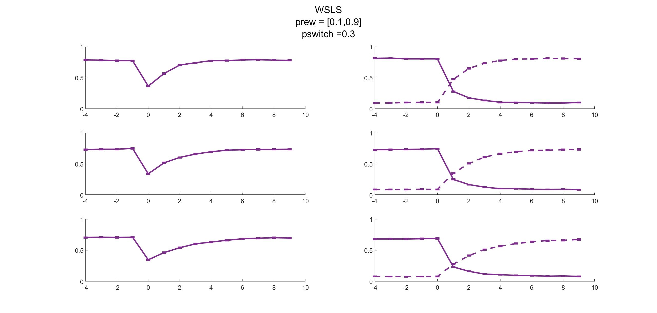

Slide 8
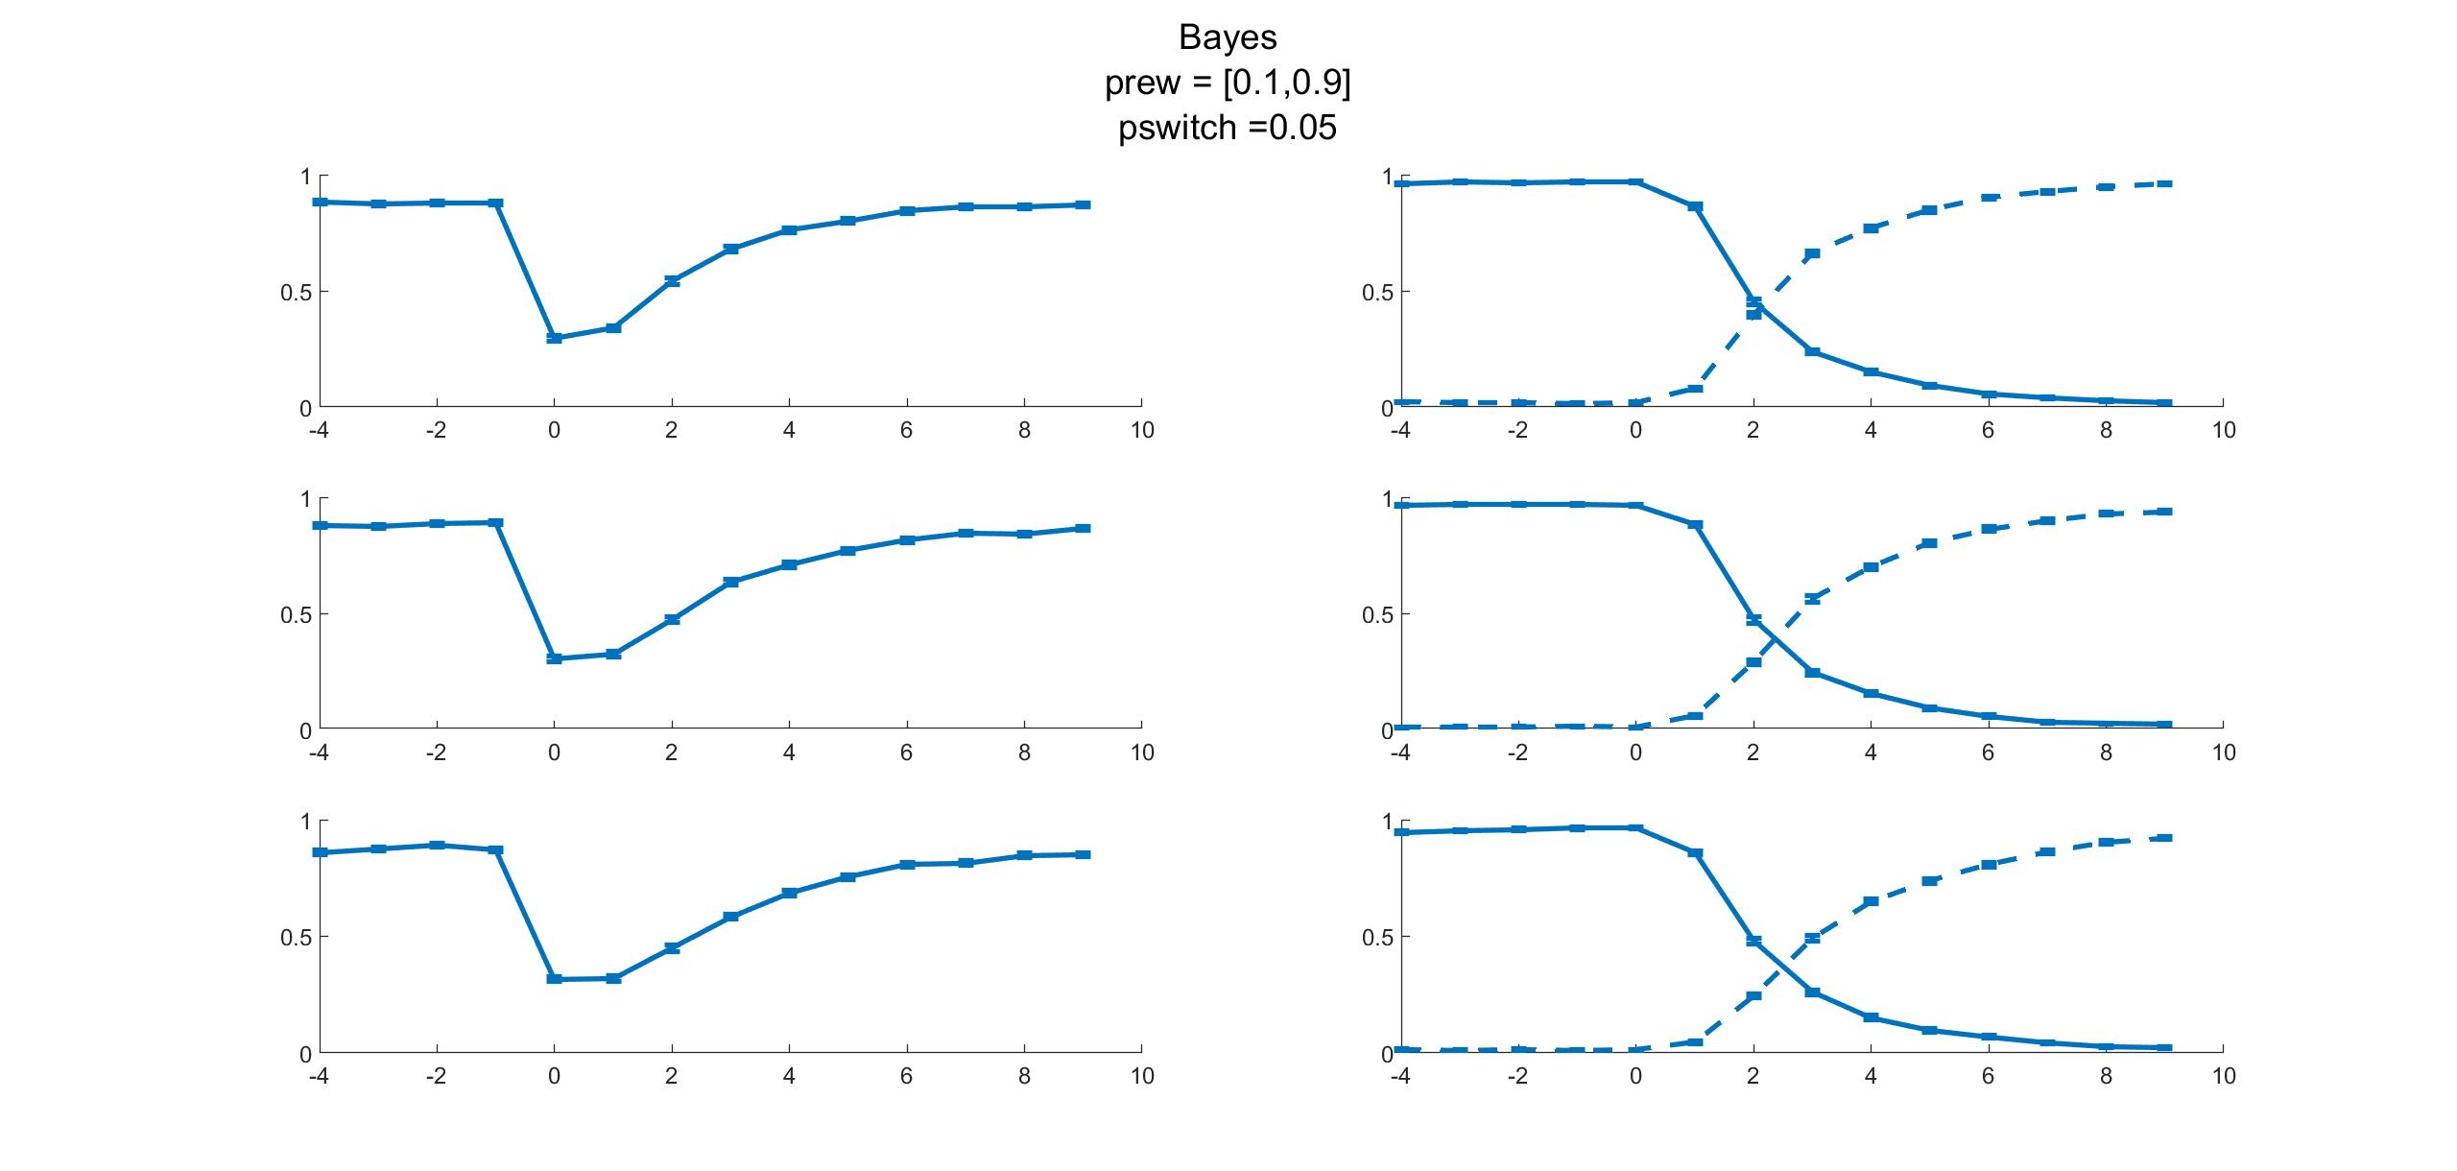
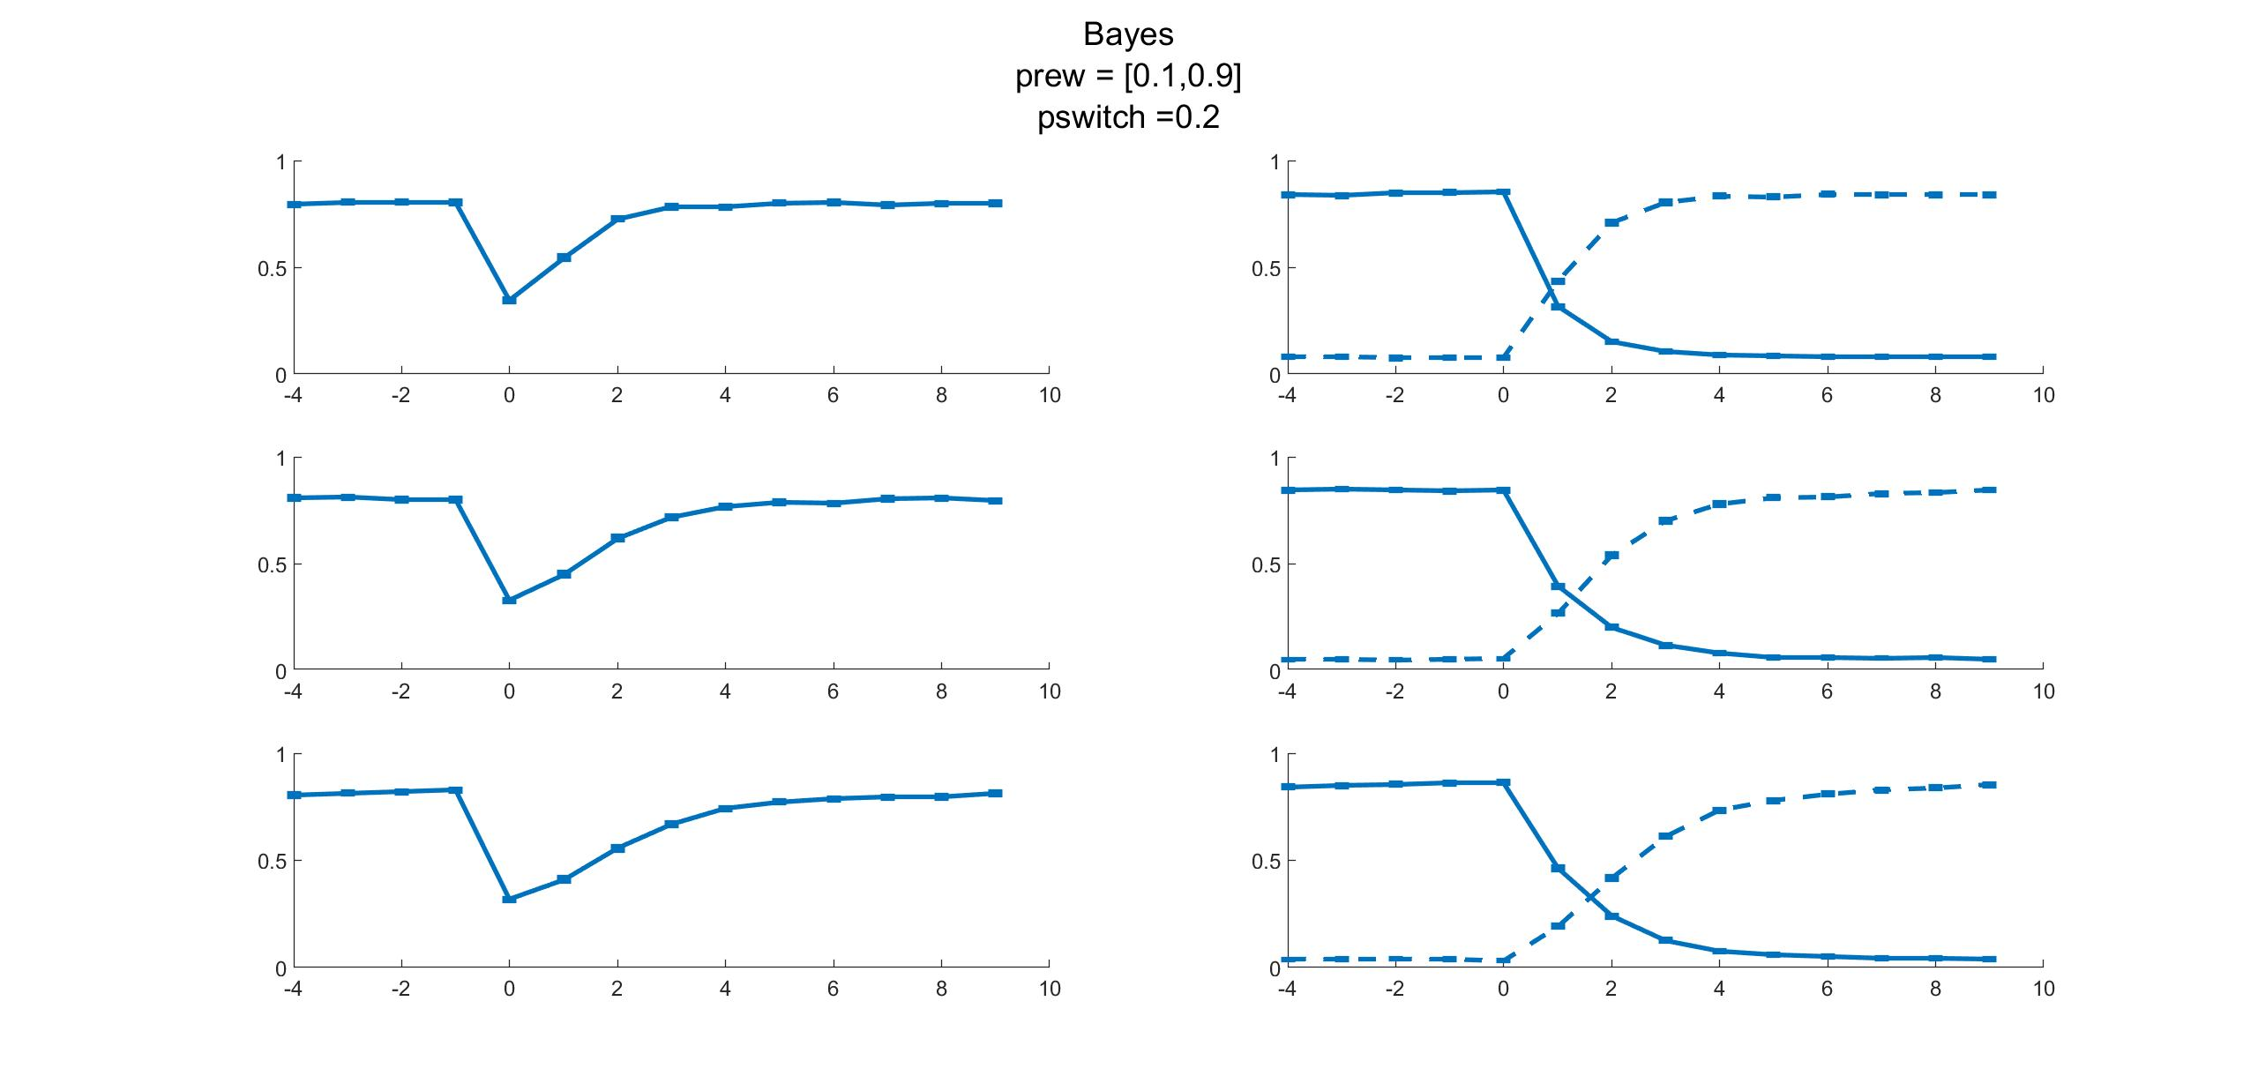

Slide 9
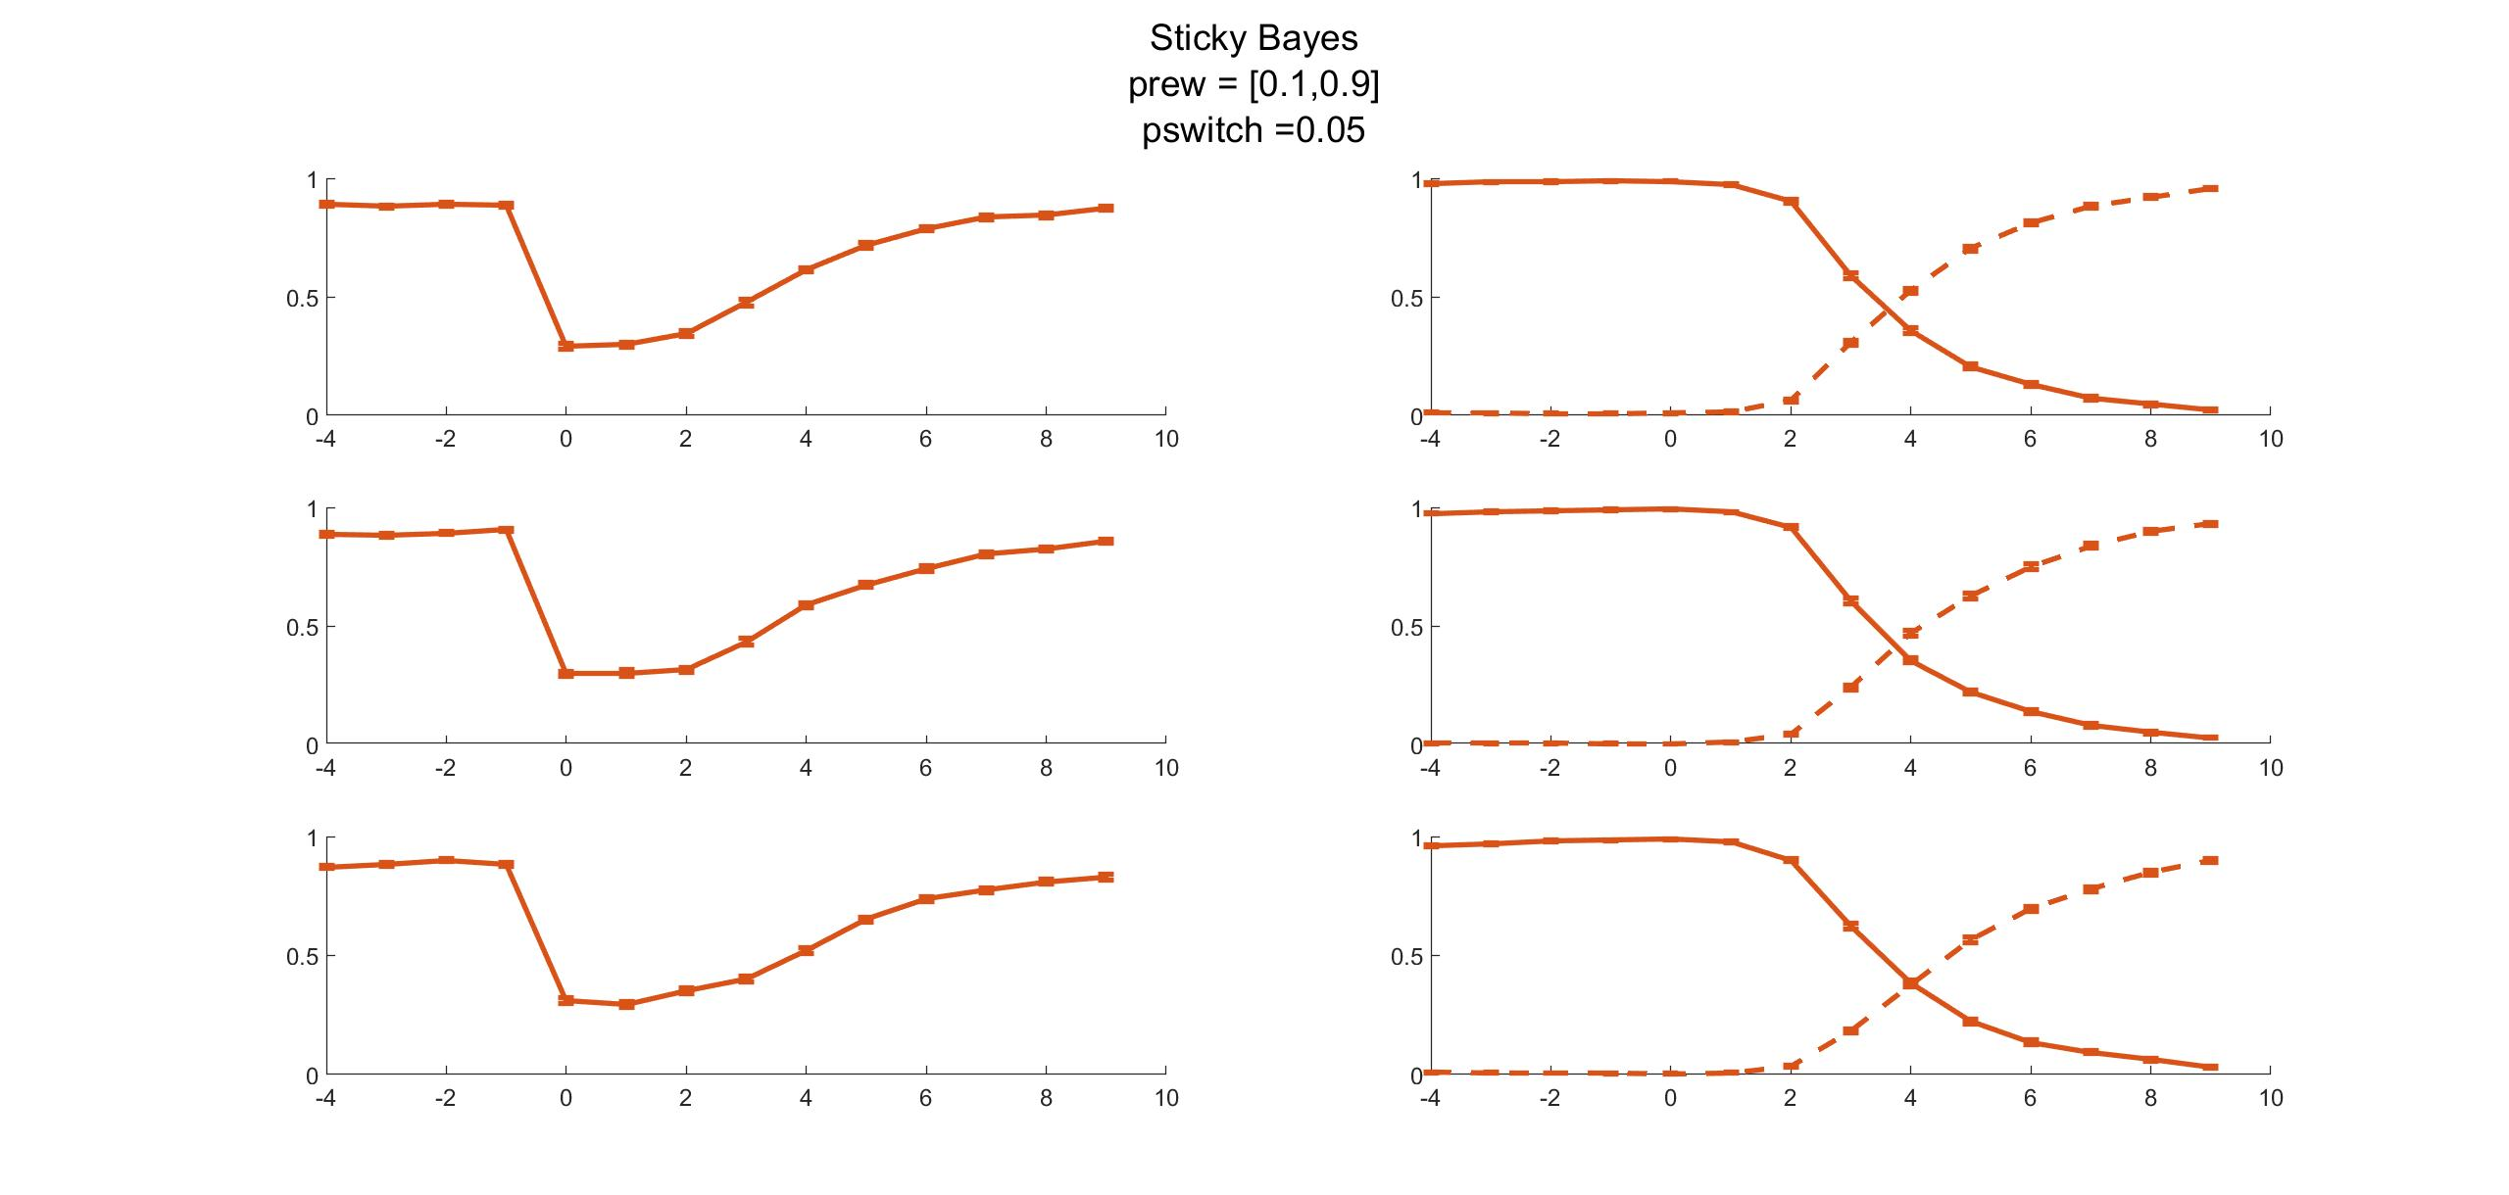
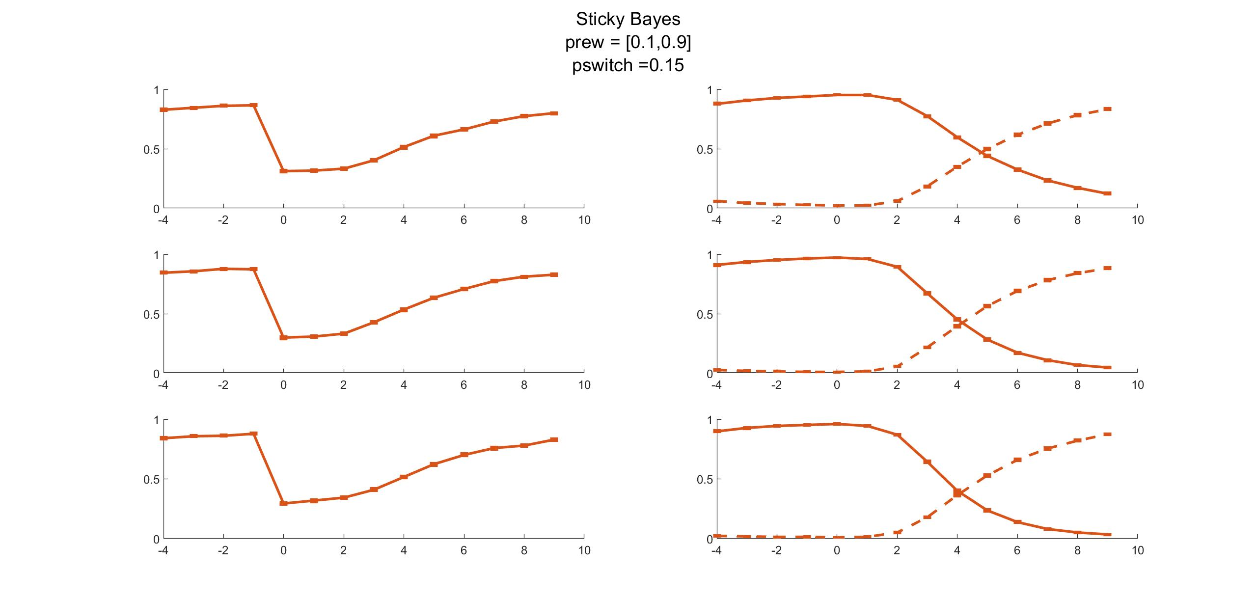
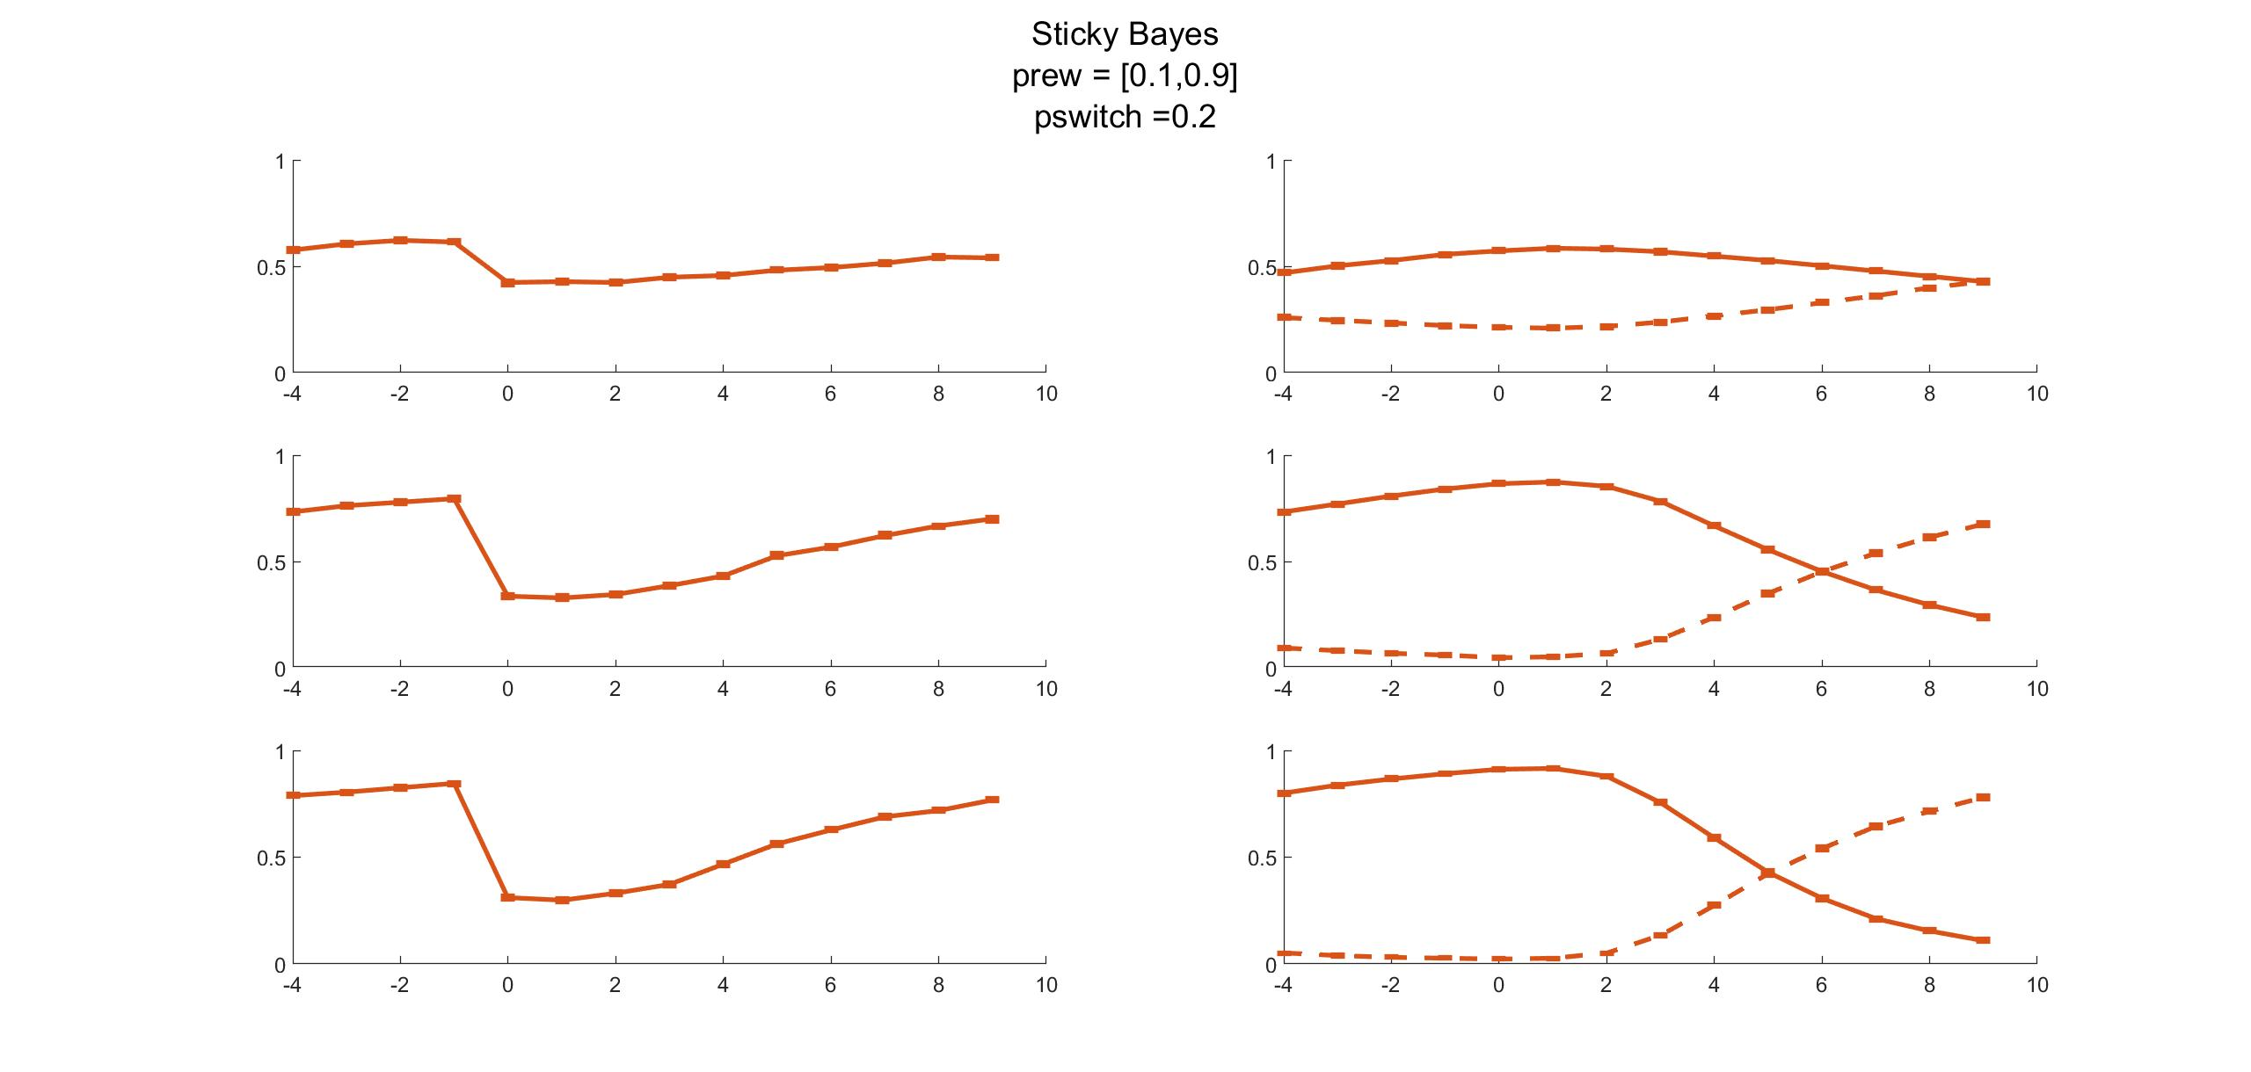

Slide 10
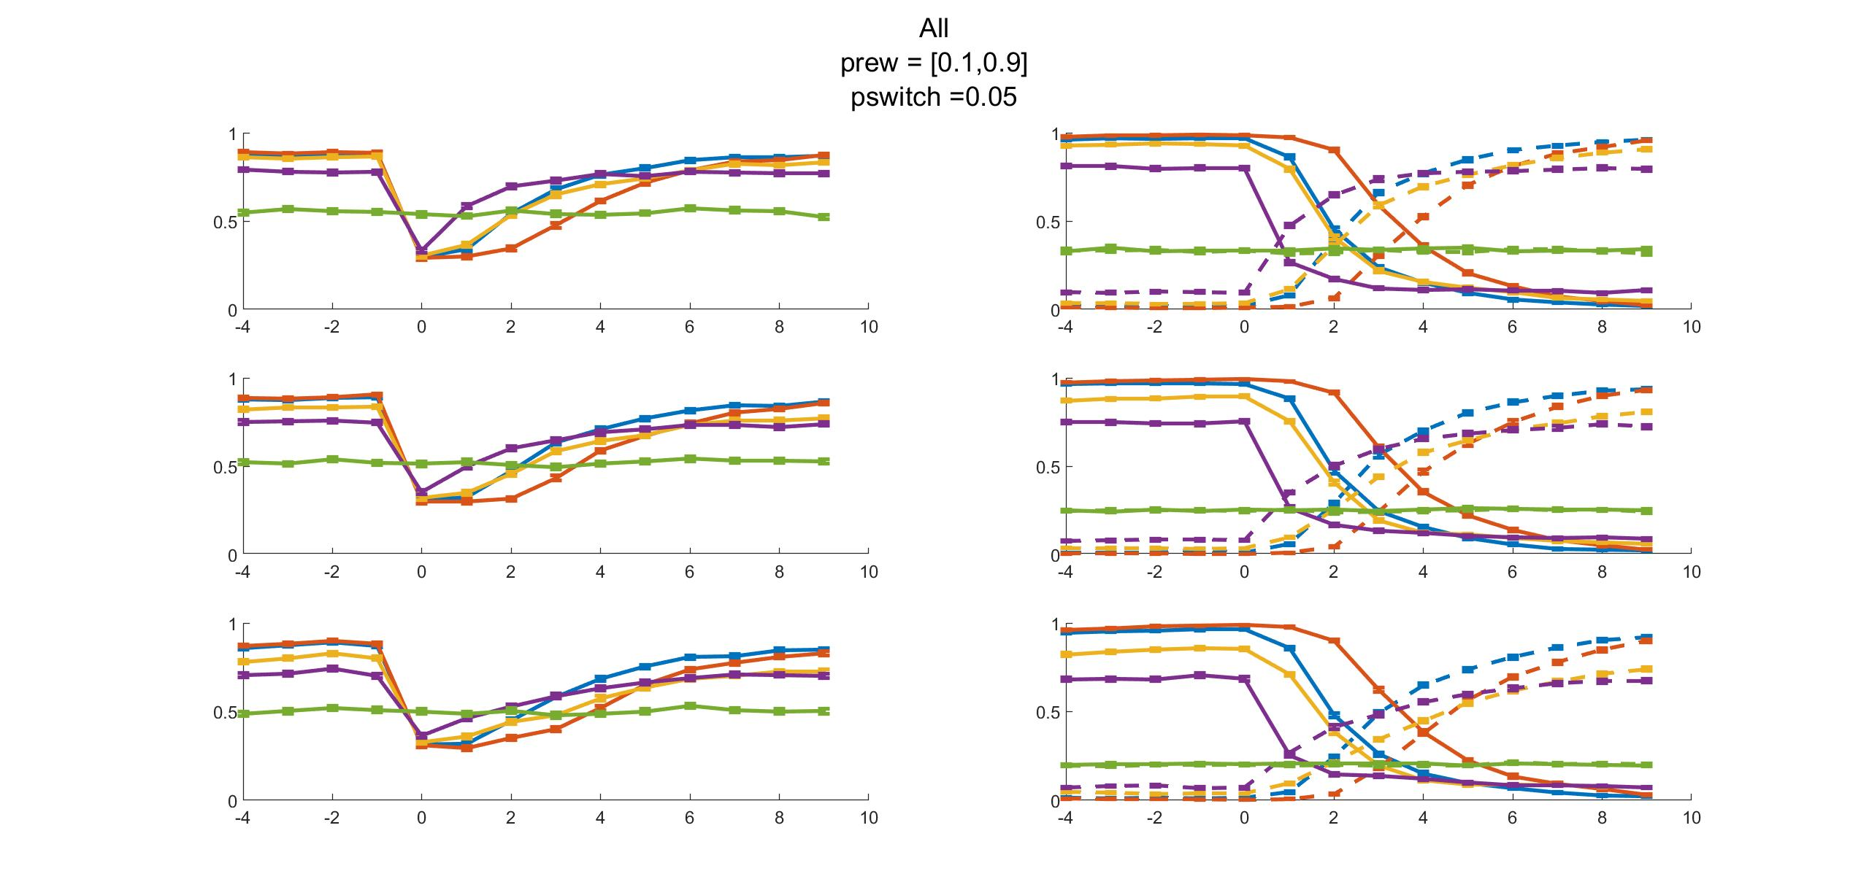
Reward Bandit (old vs new)
Nbandits
5 4 3

Slide 11
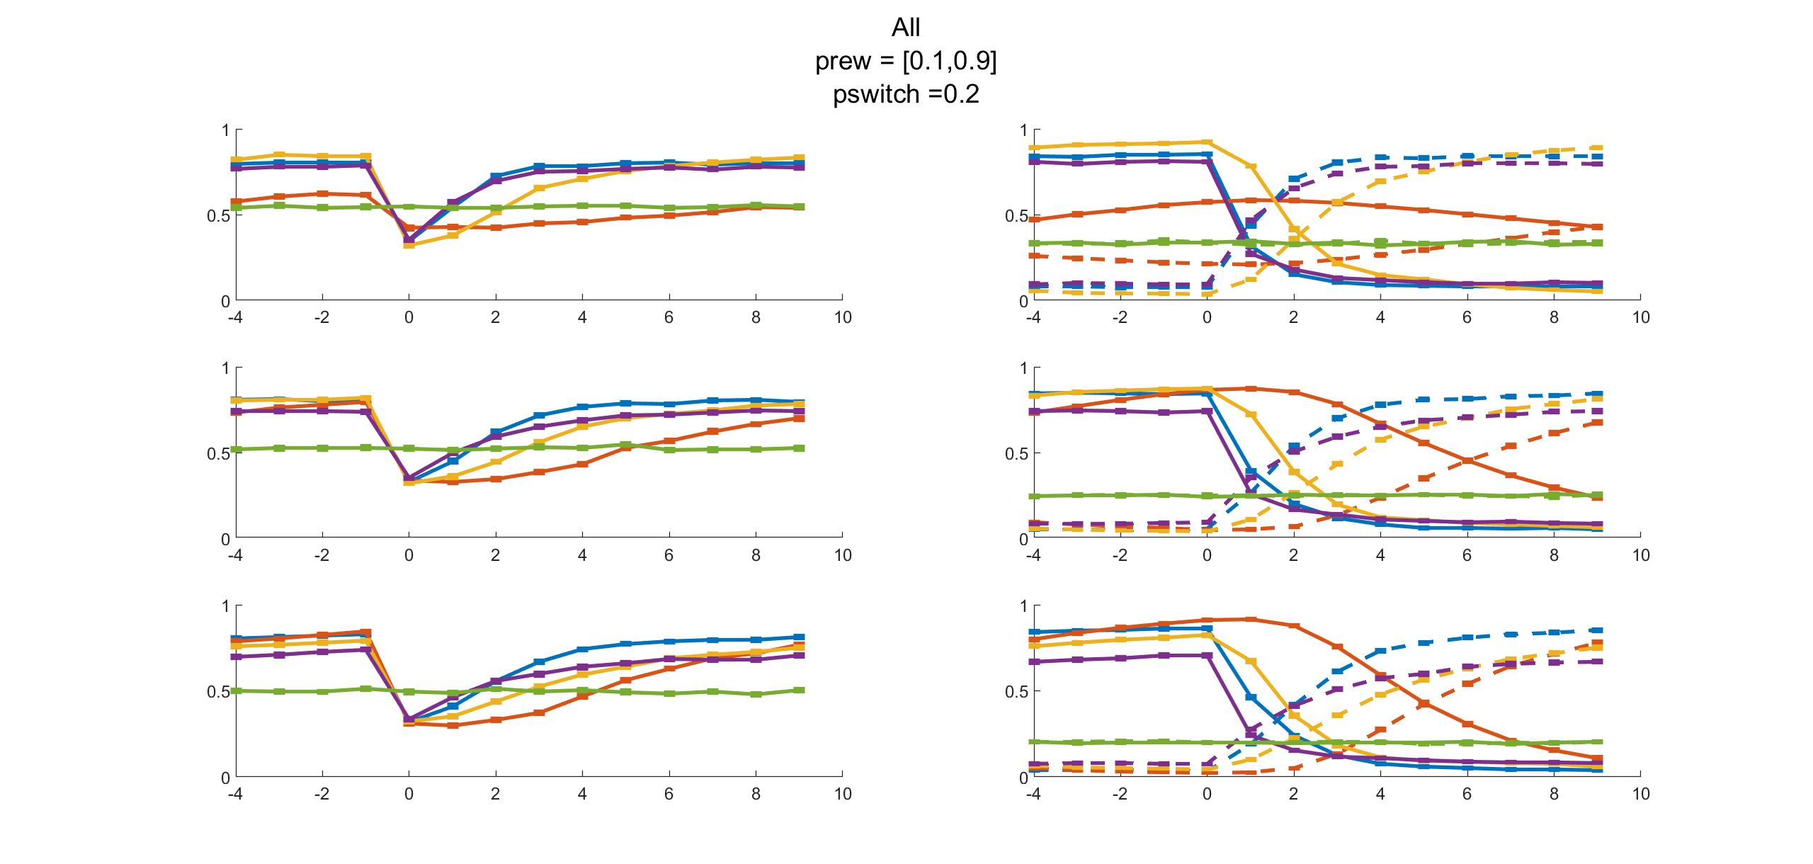
Reward Bandit (old vs new)
Nbandits
5 4 3

Slide 12
New Stimuli Generation

Slide 13
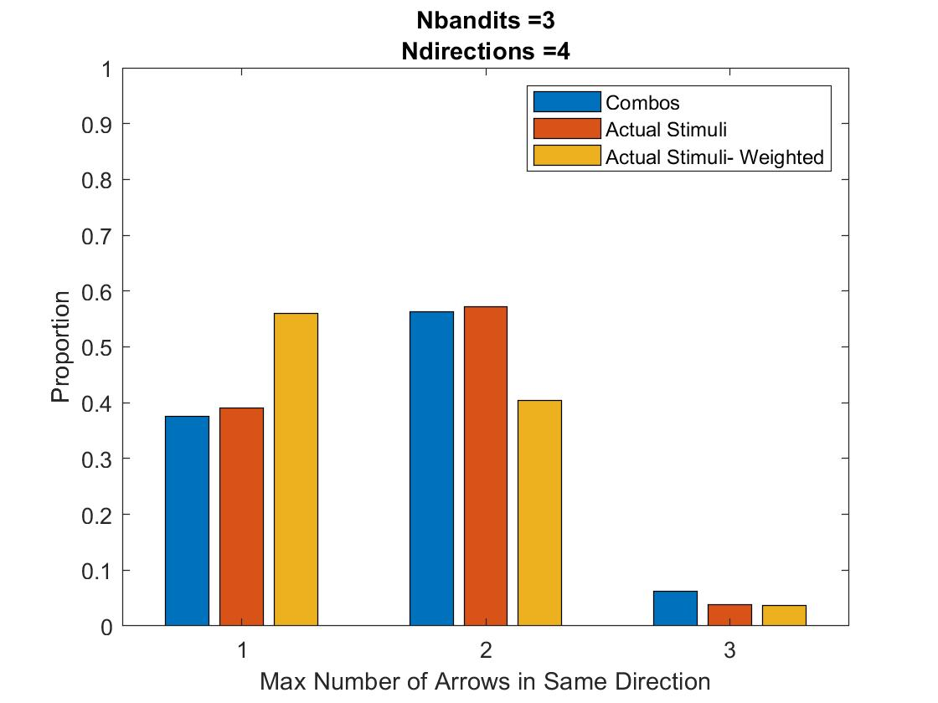
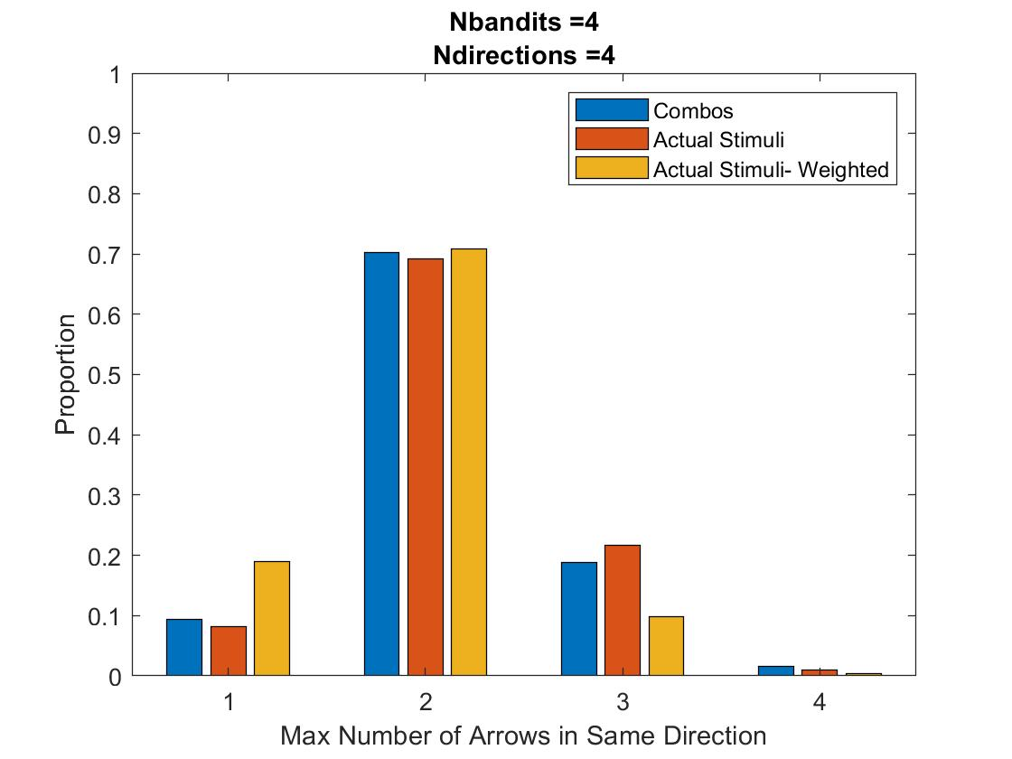
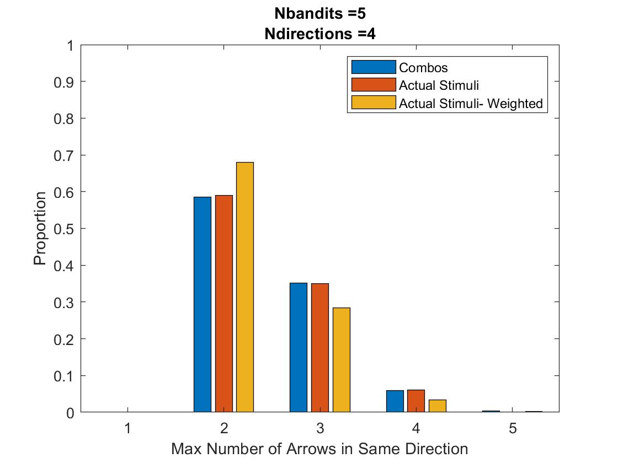
Stimuli Occurrences
Max all-same: 5% of trials
Unweighted: Psame = Pdiff = 1/Ncombos
Weighted: Psame = 1/Nbandits, Pdiff dependent on num same
Ref = 10

Slide 14
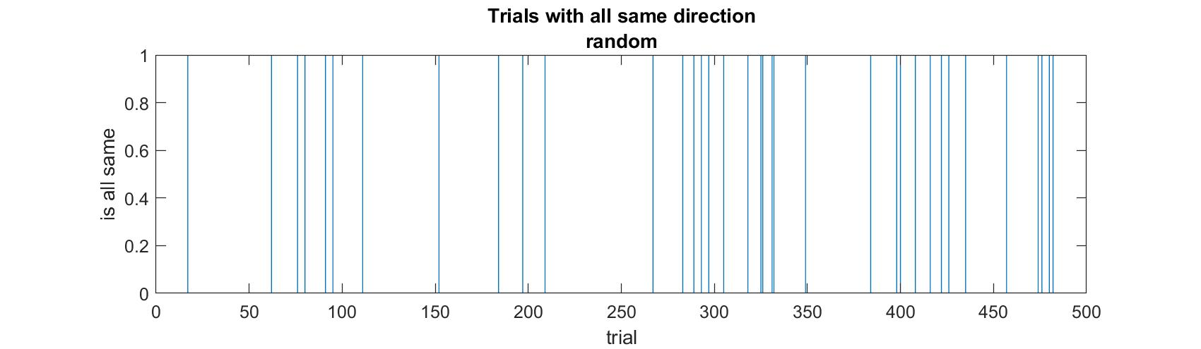
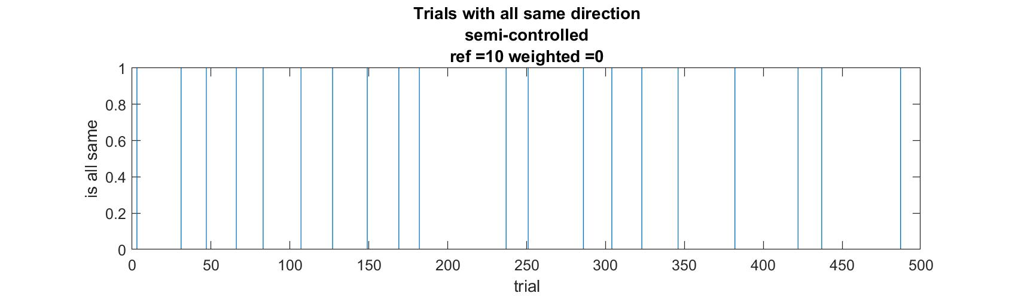
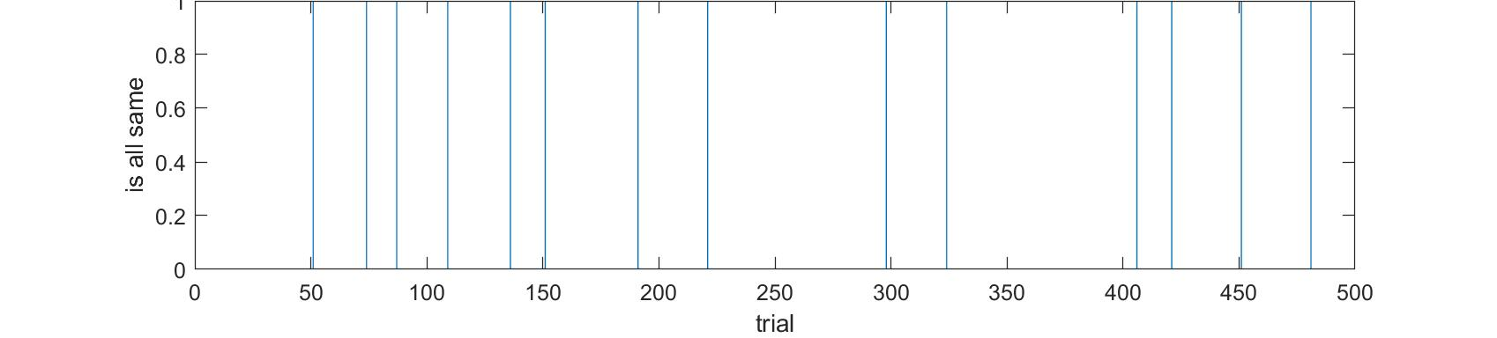
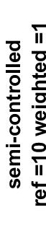
Notes:
Ndirections =4
Nbandits =3

Slide 15
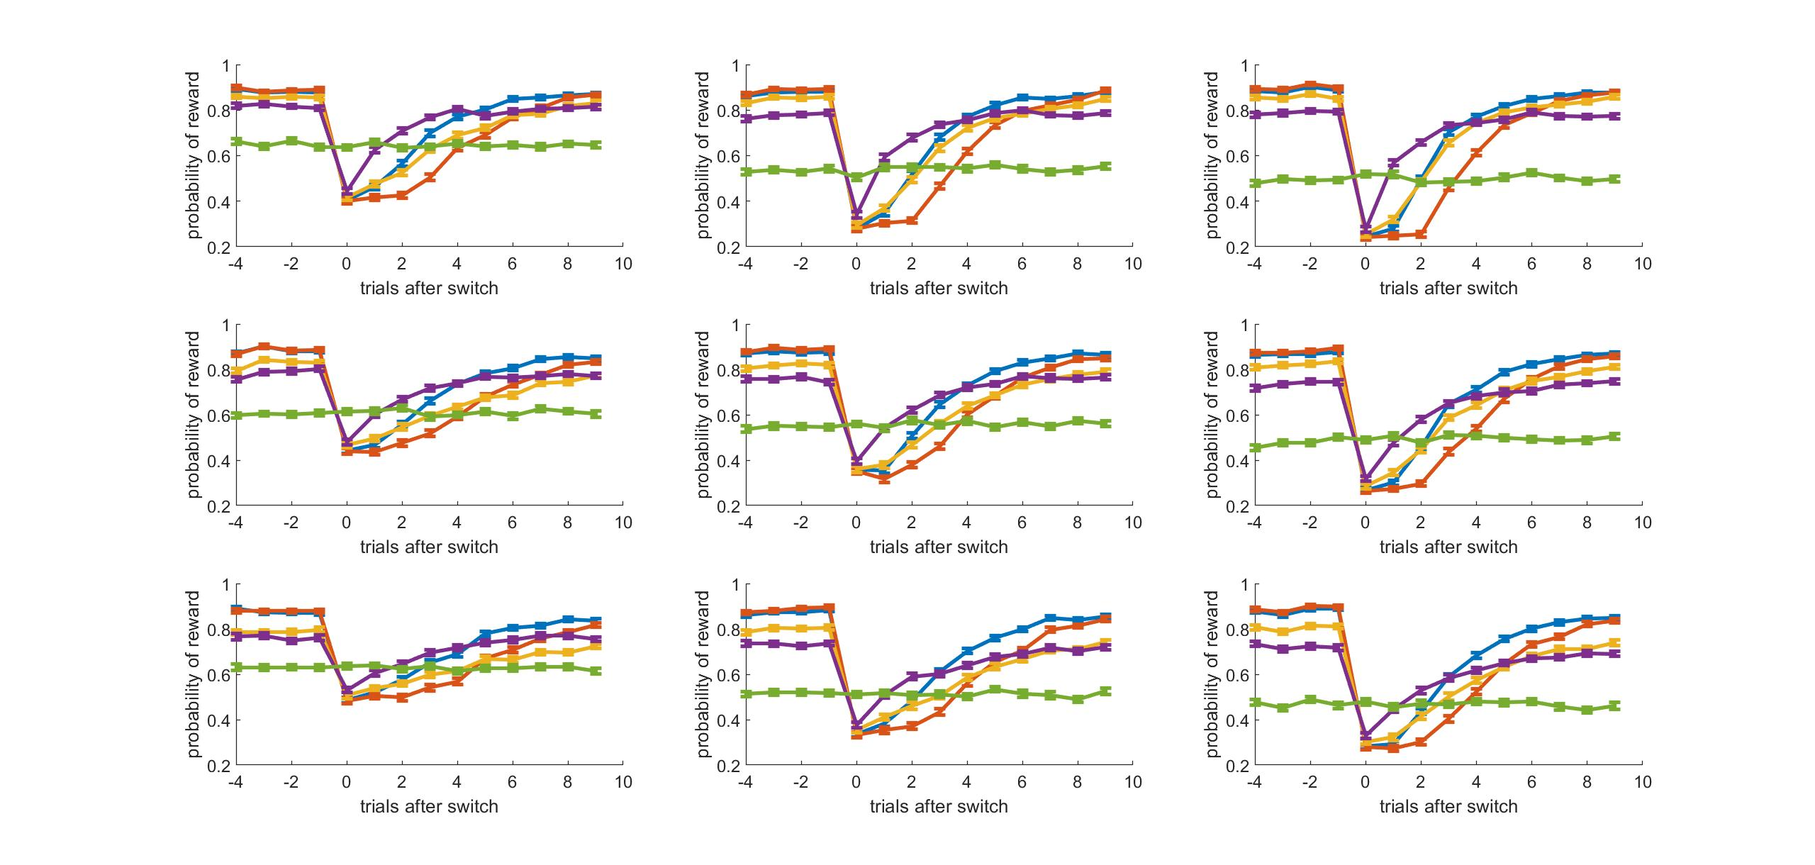
Ndirections
2 3 4
Nbandits
5 4 3
Notes:
NEW

Slide 16
Ndirections
2 3 4
Nbandits
5 4 3
Notes:
OLD

Slide 17
Curve Fitting

Slide 18
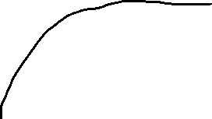
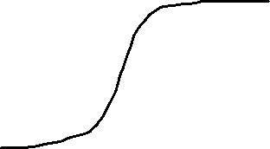
Fitting to curves to exponential
y = a + b*exp(c*x)
a to get asymptotic value?
Fit options for increasing vs decreasing functions (p_new vs p_old & rew)
Fit is best for something like WSLS which has immediate change, but worse for models that have some kind of delay/slower to change
Although r² is still good, tends not to capture shape
Good for:
Not good for:

Slide 19
Fitting to curves to logistic
y = a/(1 + exp(-k*(x-b)))
a -> asymptotic value
k -> steepness
b -> midpoint
Good for:

Slide 20
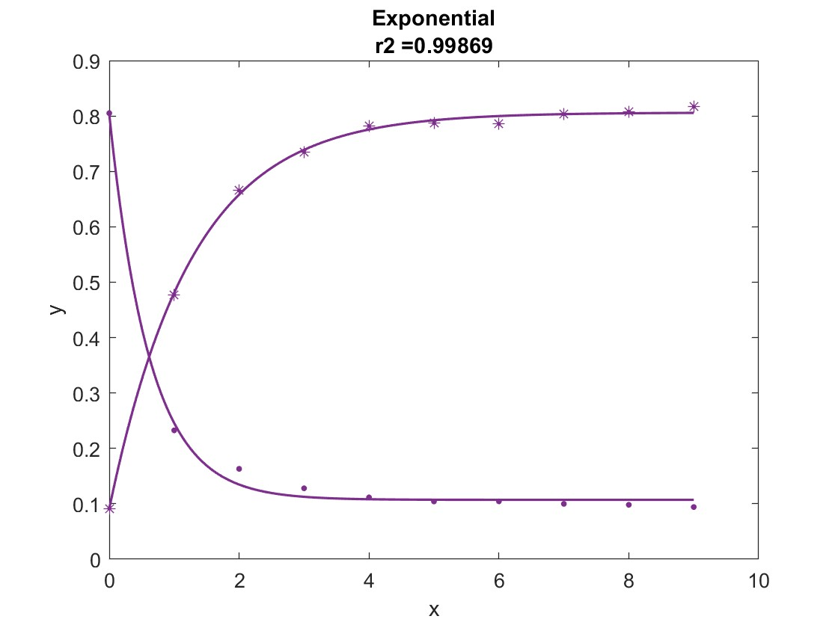
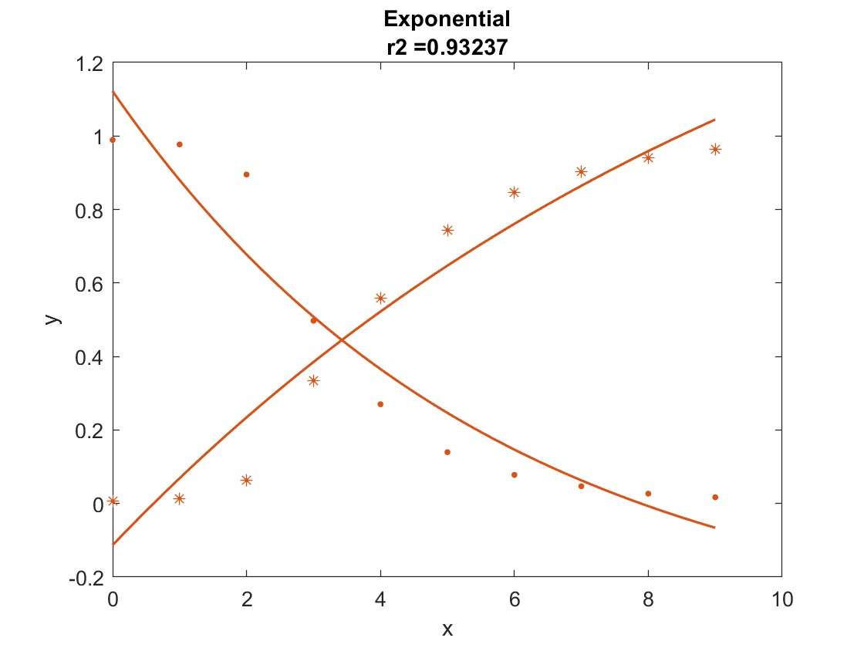
Exponential Examples
Old Bandit (.)
New Bandit (*)
WSLS
Sticky Bayes
Notes:
Both have good r2 values but fit doesn’t capture shape well

Slide 21
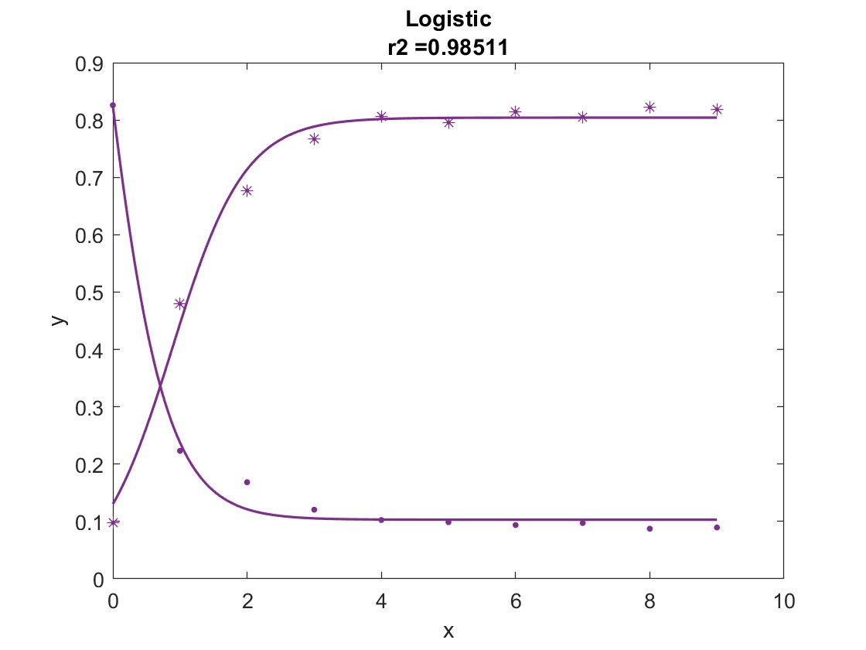
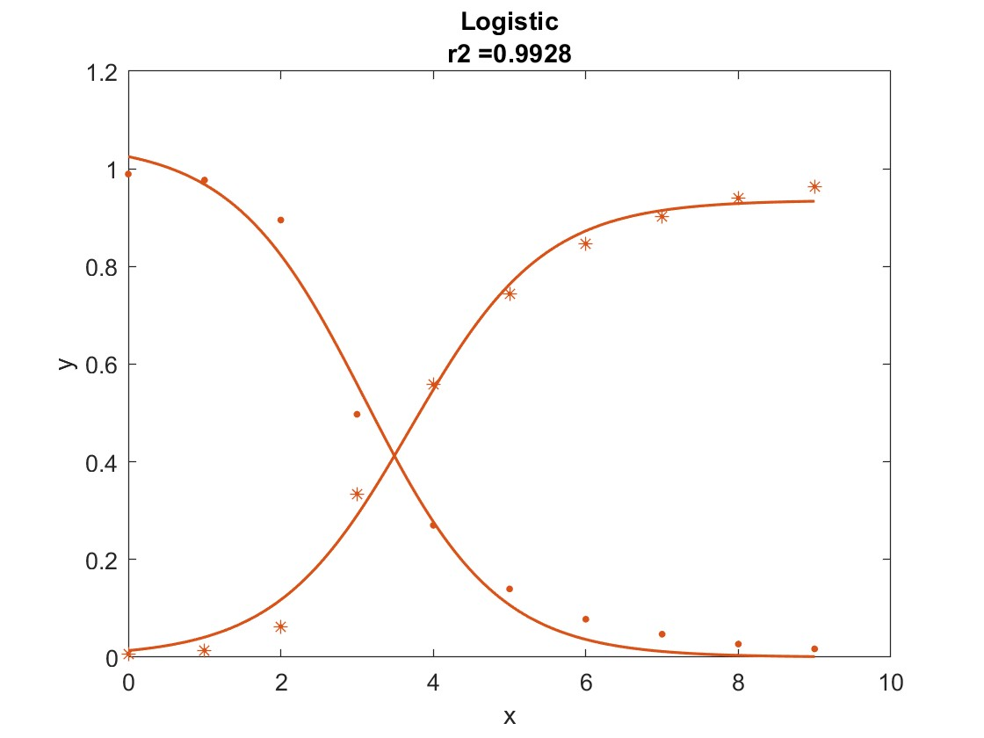
Logistic Examples
Old Bandit (.)
New Bandit (*)
WSLS
Sticky Bayes
Notes:
Both have good r2 values but fit doesn’t capture shape well

Slide 22
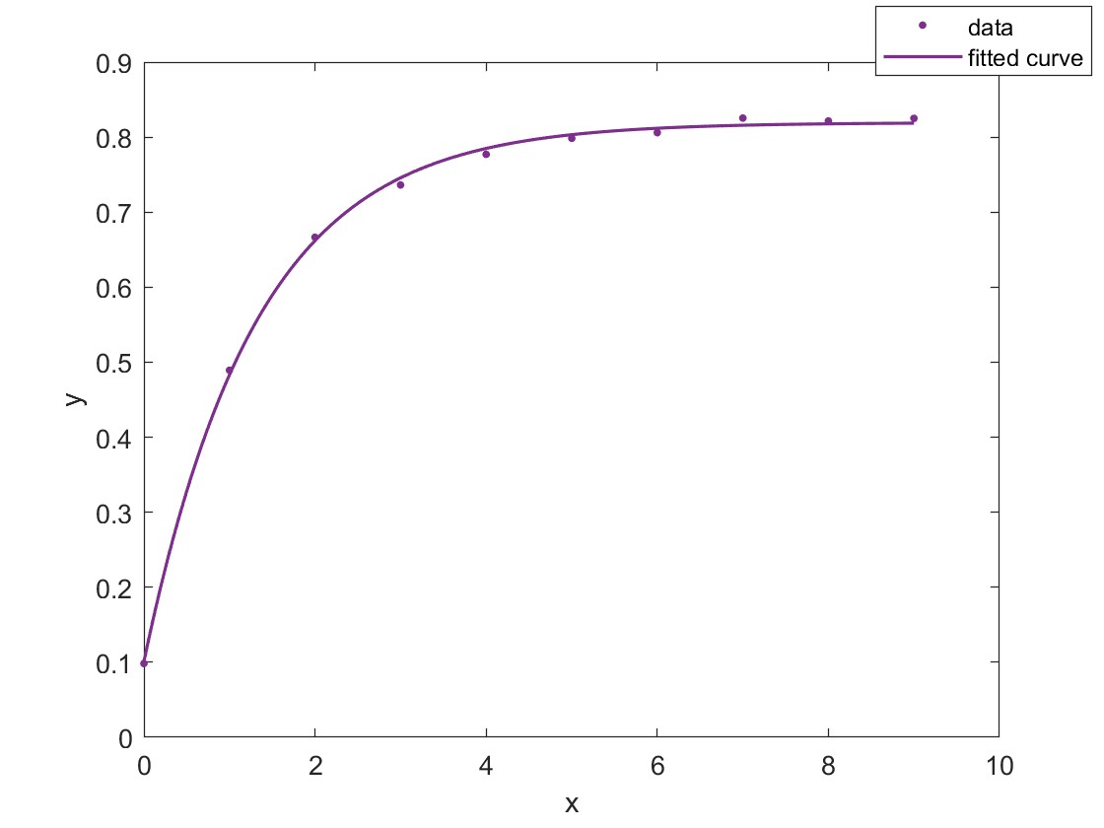
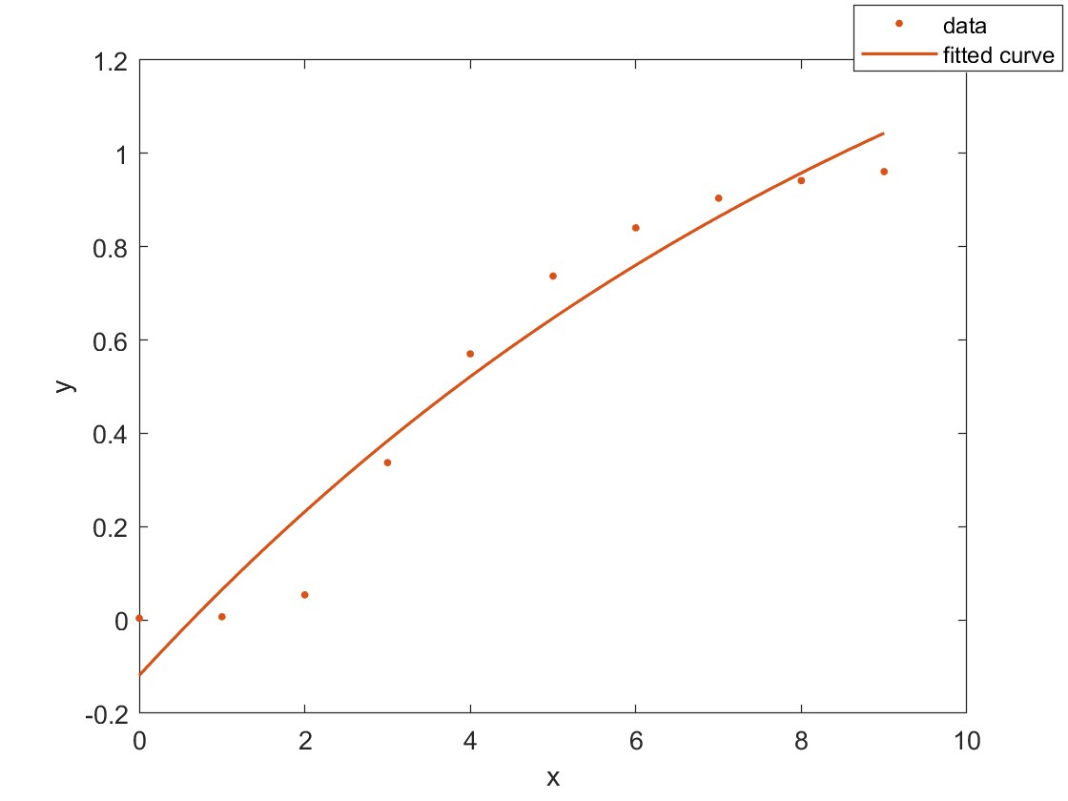
Examples
New Bandit
WSLS
Sticky Bayes
Notes:
Both have good r2 values but fit doesn’t capture shape well

Slide 23
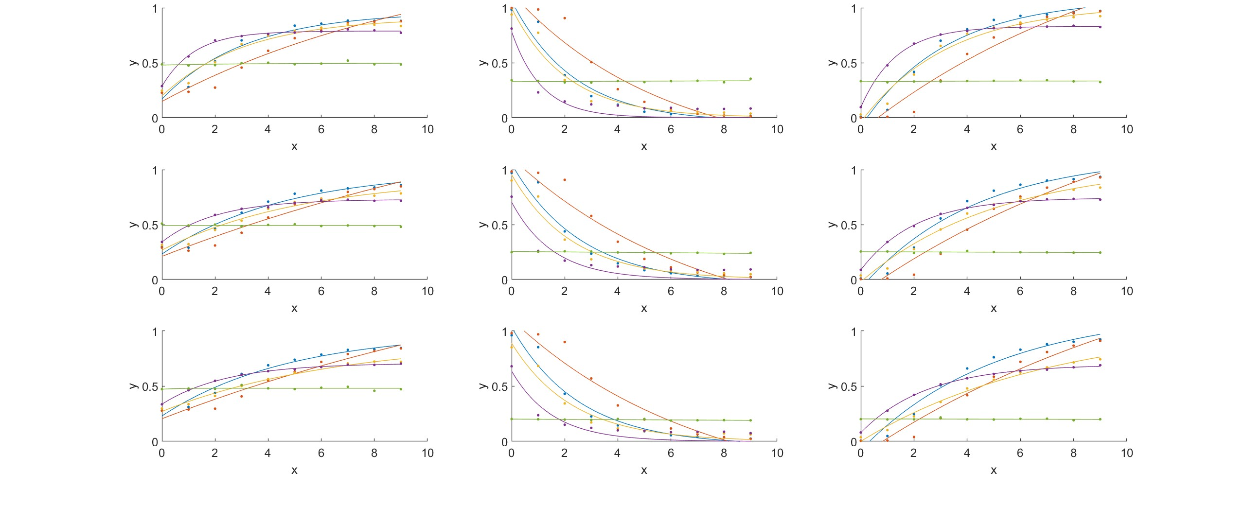
Fitting to curves to exponential- examples
Reward
Old Bandit
New Bandit

Slide 24
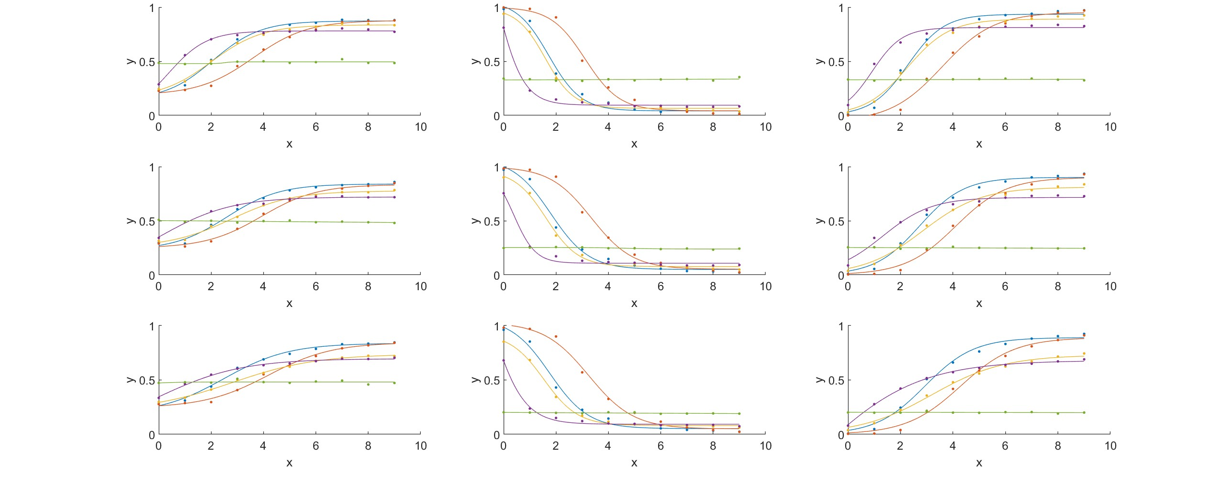
Fitting to curves to logistic- examples
Reward
Old Bandit
New Bandit

